Slide 1


Sieun
Yeongchan
Chaihwan
Minju
©2025

Slide 2



Slide 3

Personal Identity
Futuristic Vision
Customization
©2025

Slide 4

LIST OF CONTENT
01
Timeline
02
Color / Font
03
Wireframe
04
Main page
05
Sub page
06
Media
©2025

Slide 5






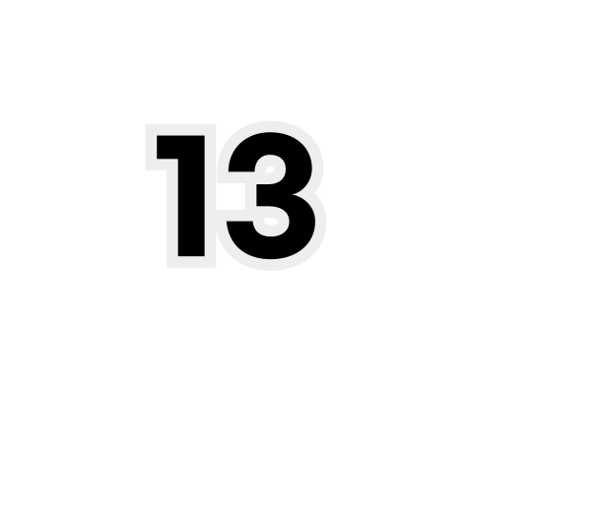

sub wire
sub cording
sub design
ppt
TIMELINE
main design
main cording
main wire
presentation
©2025

Slide 6





COLOR
#a3abb8
#d6dcea
#eeeff3
#c3cbd8
#808083
A soft, muted blue-grey that feels like morning fog settling over a modern cityscape. It carries a subtle metallic undertone, making it both calming and sophisticated — the kind of color you’d see on brushed steel bathed in pale light.
A delicate, airy blue that feels like the faint tint of a spring sky just after sunrise. It’s clean, fresh, and effortlessly uplifting, as if a cool breeze were passing through sheer curtains.
Almost white, yet kissed with the faintest silver hue. This shade resembles frost resting on glass, radiating purity and lightness, perfect for a minimalist and polished aesthetic.
A balanced blend of silver and blue, reminiscent of an overcast horizon at sea. It’s serene, steady, and has a quietly luxurious character.
A deep, industrial grey with a hint of blue, evoking the elegance of skyscrapers and modern architecture. It’s bold without being overpowering, grounding a palette with timeless strength.
©2025

Slide 7




FONT
에스코어드림
https://noonnu.cc/font_page/223
Cormorant Garamond
https://fonts.google.com/specimen/Cormorant+Garamond?preview.text=CLOSET%20MAKEUP%20&categoryFilters=Technology:%2FTechnology%2FVariable
©2025

Slide 8

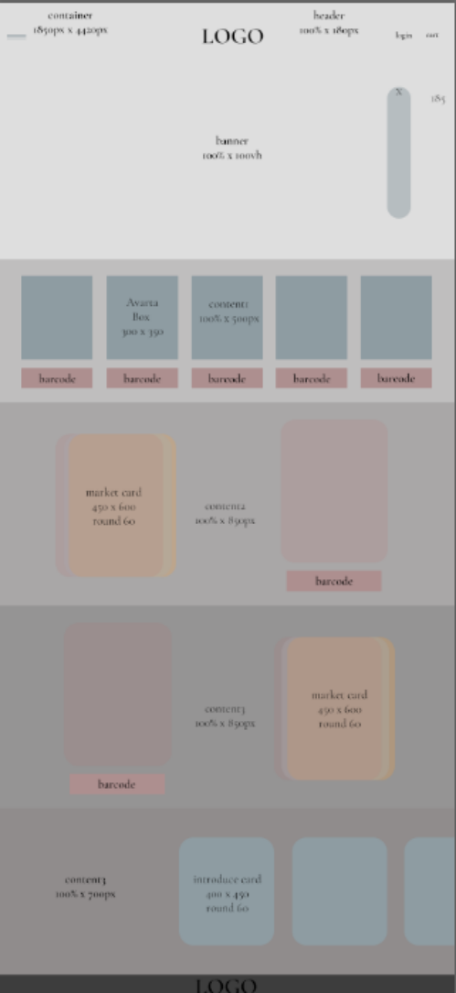
#HEADER
#BANNER
WIREFRAME
#CONTENT
#FOOTER
©2025

Slide 9
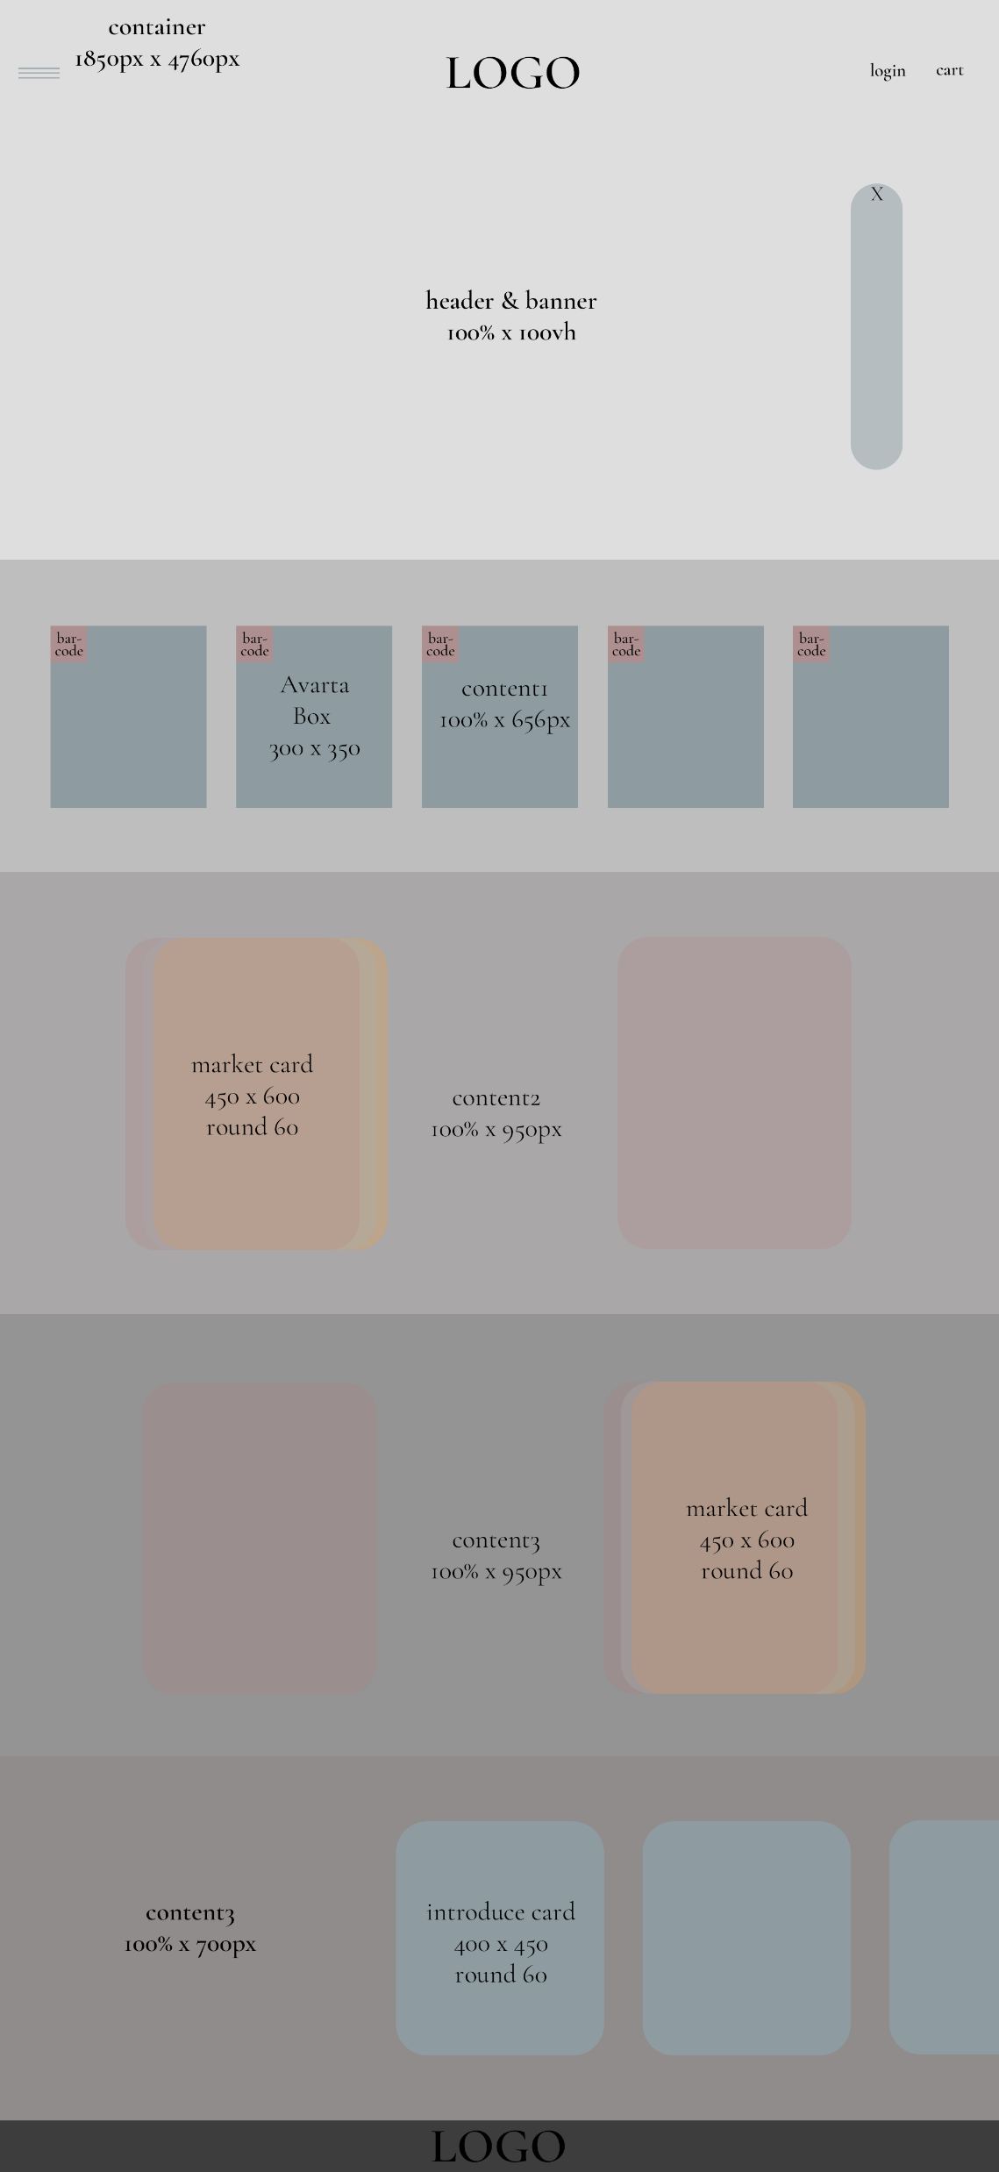
HEADER
&
FOOTER
©2025

Slide 10
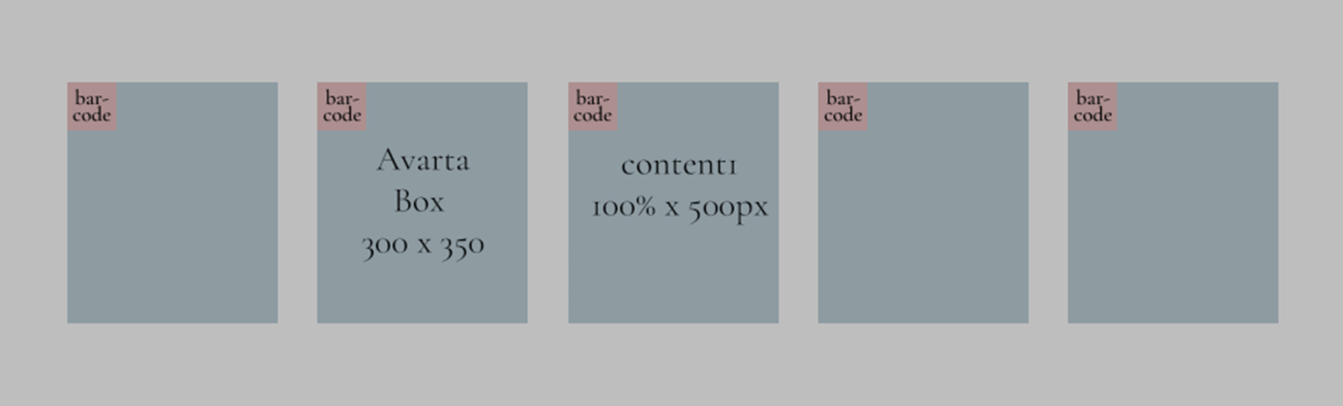
CONTENT 1
©2025

Slide 11
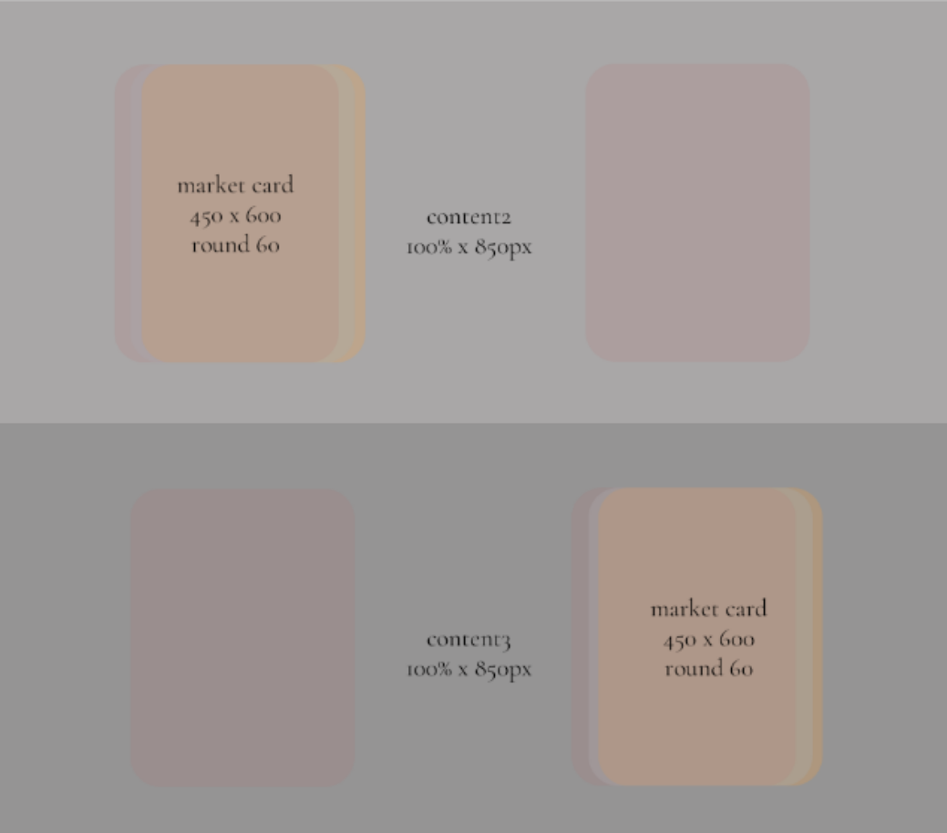
CONTENT 2,3
©2025

Slide 12

CONTENT 3
©2025

Slide 13
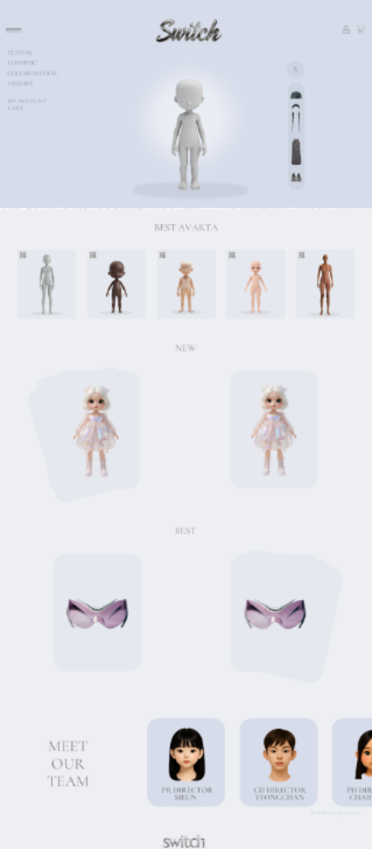
MAIN
©2025

Slide 14
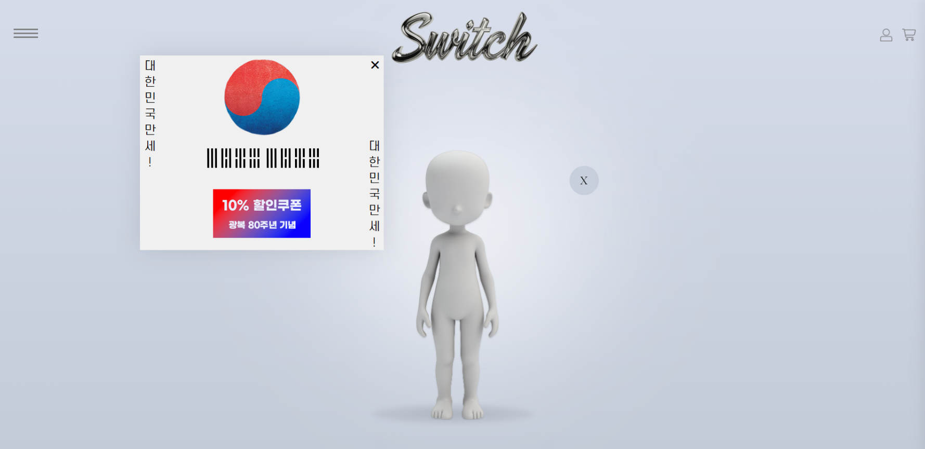
POP-UP
©2025

Slide 15

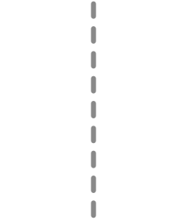
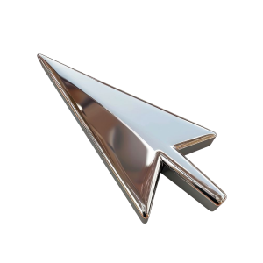



LOGIN
CART
HAMBURGER
©2025

Slide 16
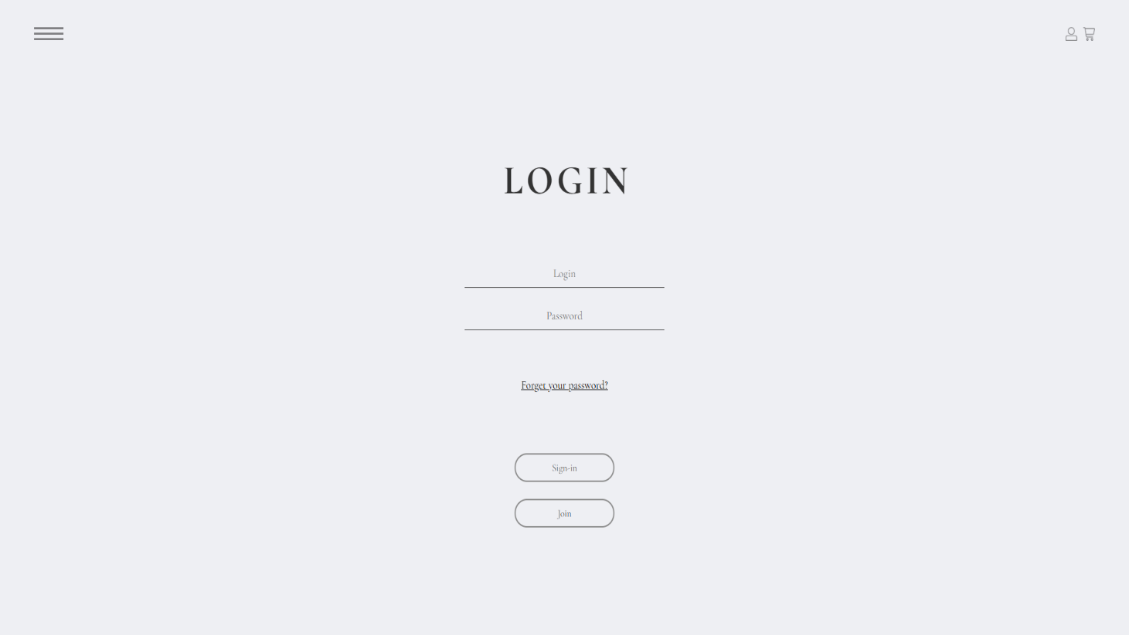

LOGIN
©2025

Slide 17

CART
©2025

Slide 18
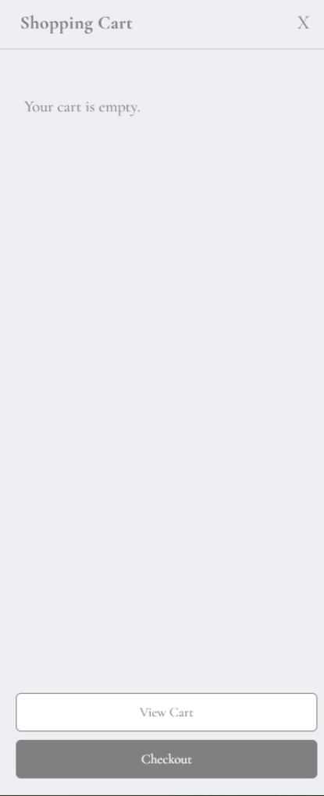
CART
©2025

Slide 19
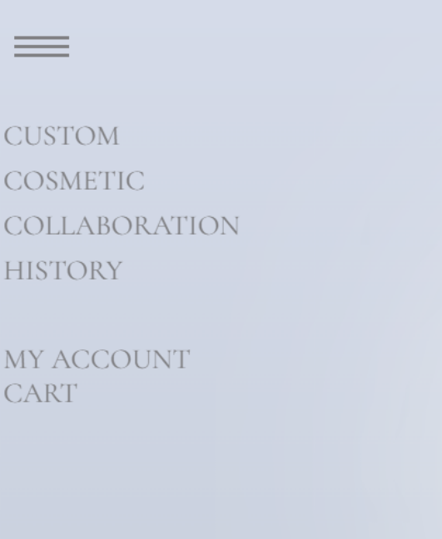
HAMBUGER
©2025

Slide 20
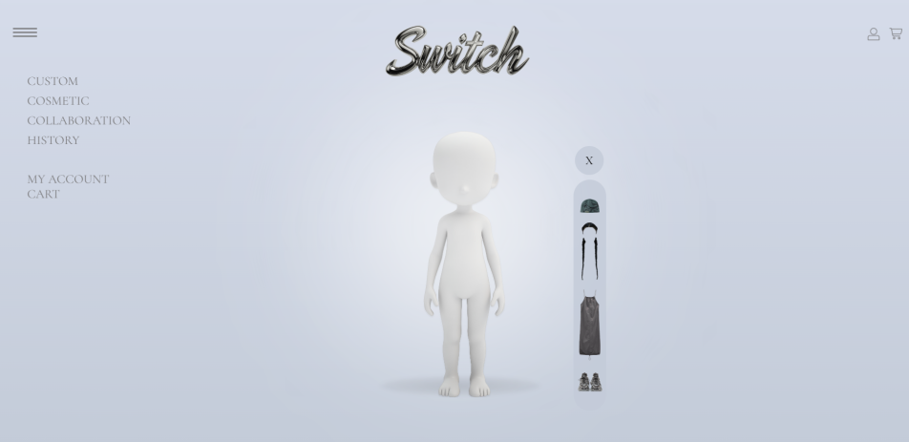
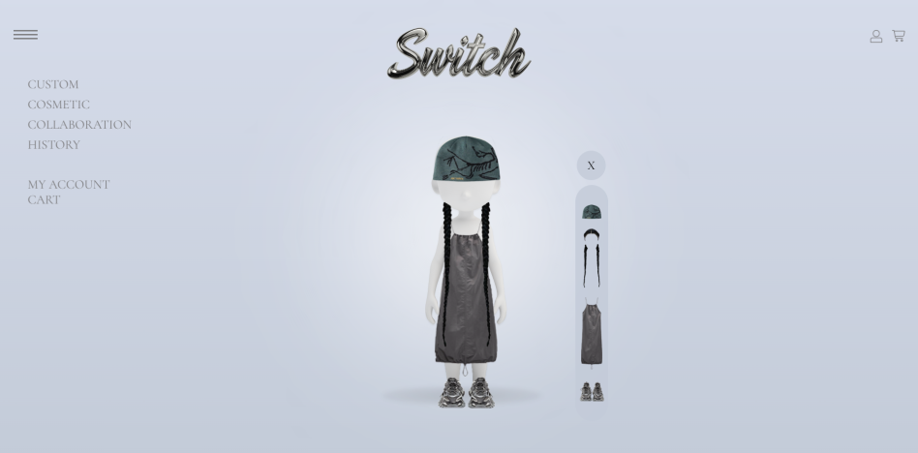
HEADER
&
BANNER
©2025

Slide 21
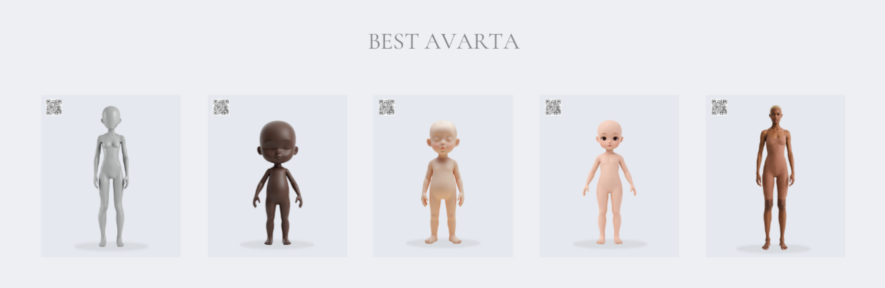
CONTENT 1
©2025

Slide 22

CONTENT 1
©2025

Slide 23
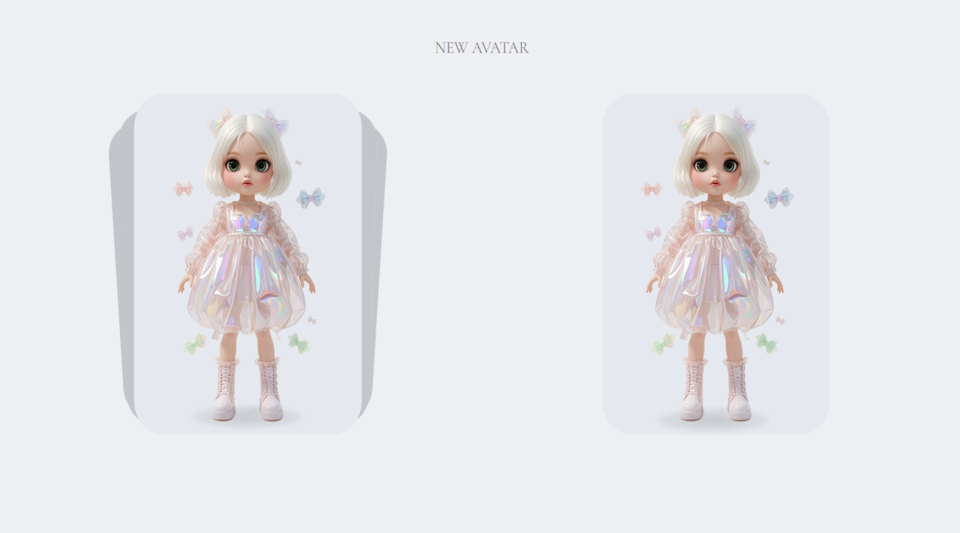
CONTENT 2
©2025

Slide 24
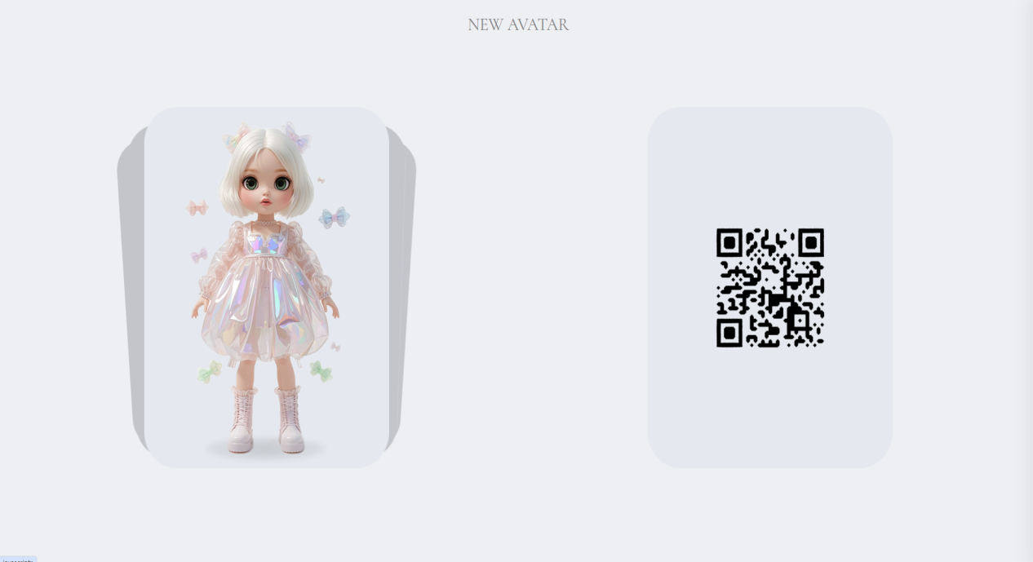
CONTENT 2
©2025

Slide 25
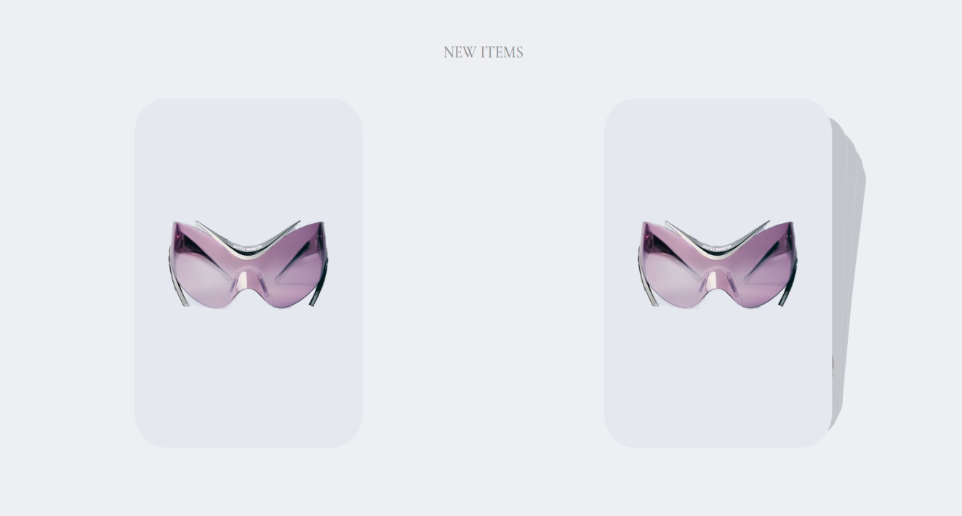
CONTENT 3
©2025

Slide 26
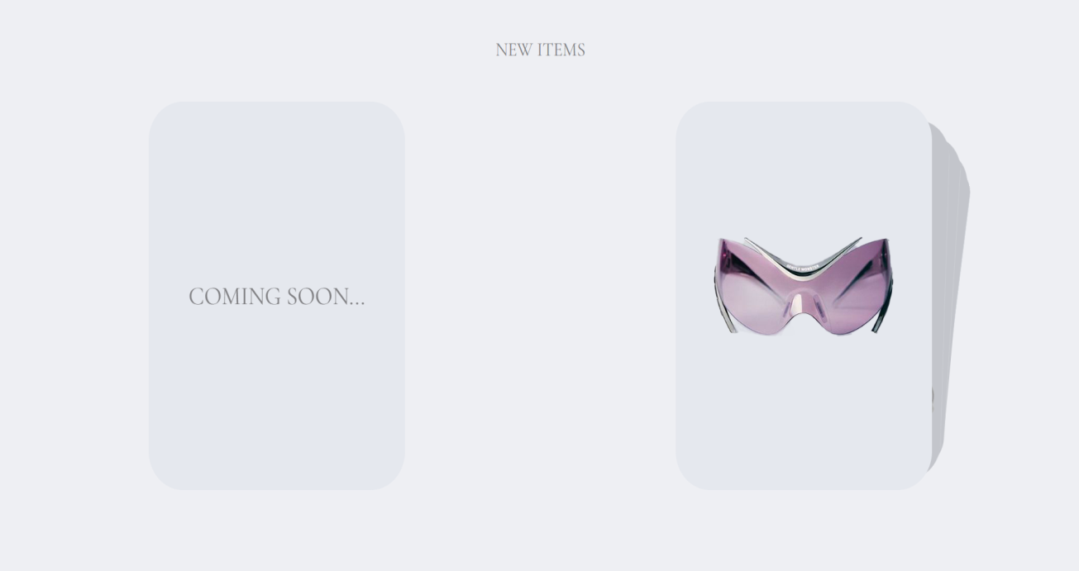
CONTENT 3
©2025

Slide 27
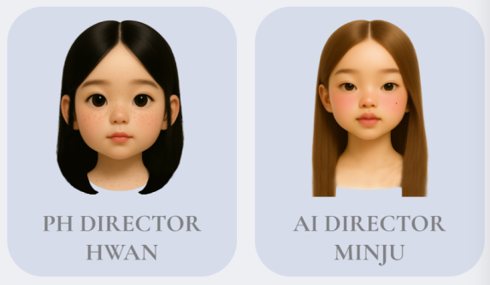

CONTENT4
©2025

Slide 28
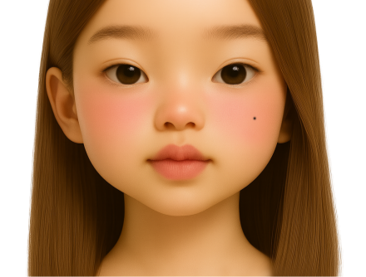
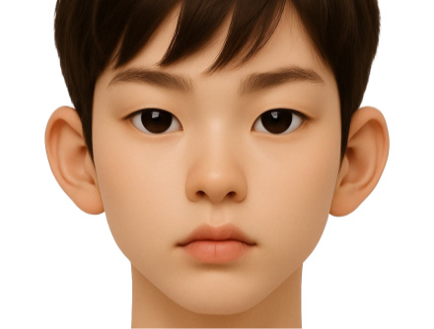
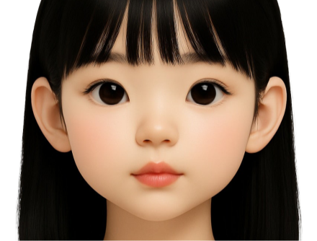
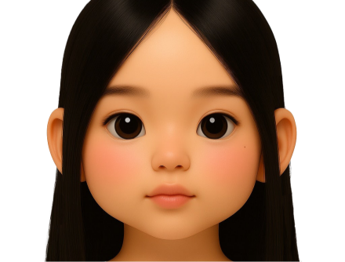
SUBPAGE
sub 1
sub 2
Custormazing
Cosmetic
sub 3
sub 4
Collaboration
History
©2025

Slide 29
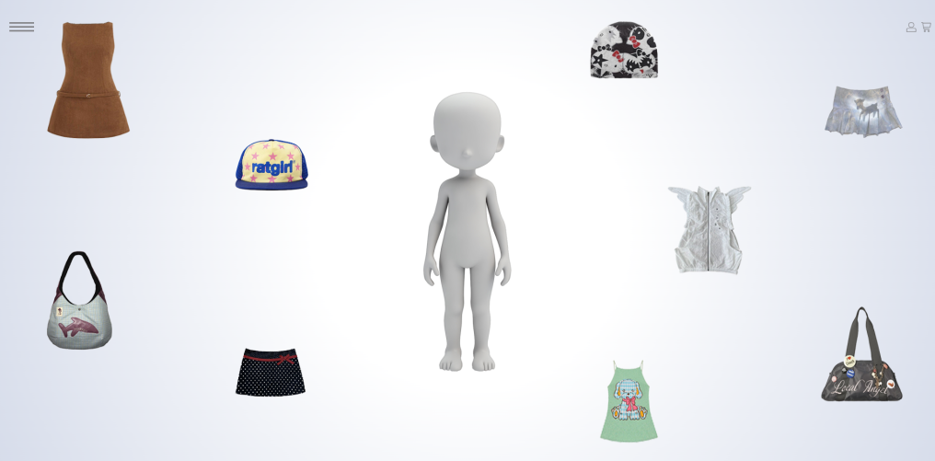
SUB1
©2025

Slide 30
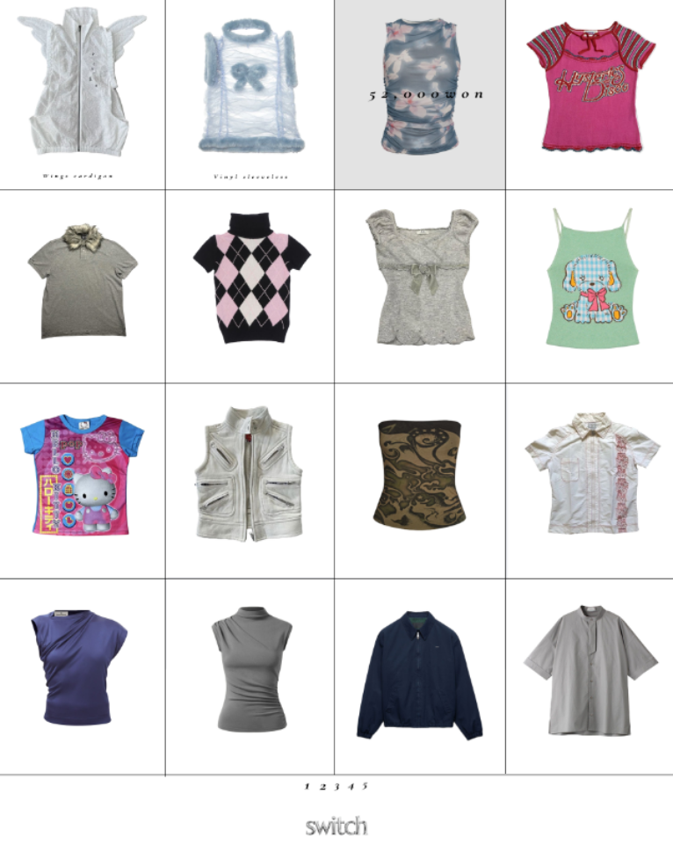
SUB1
©2025

Slide 31
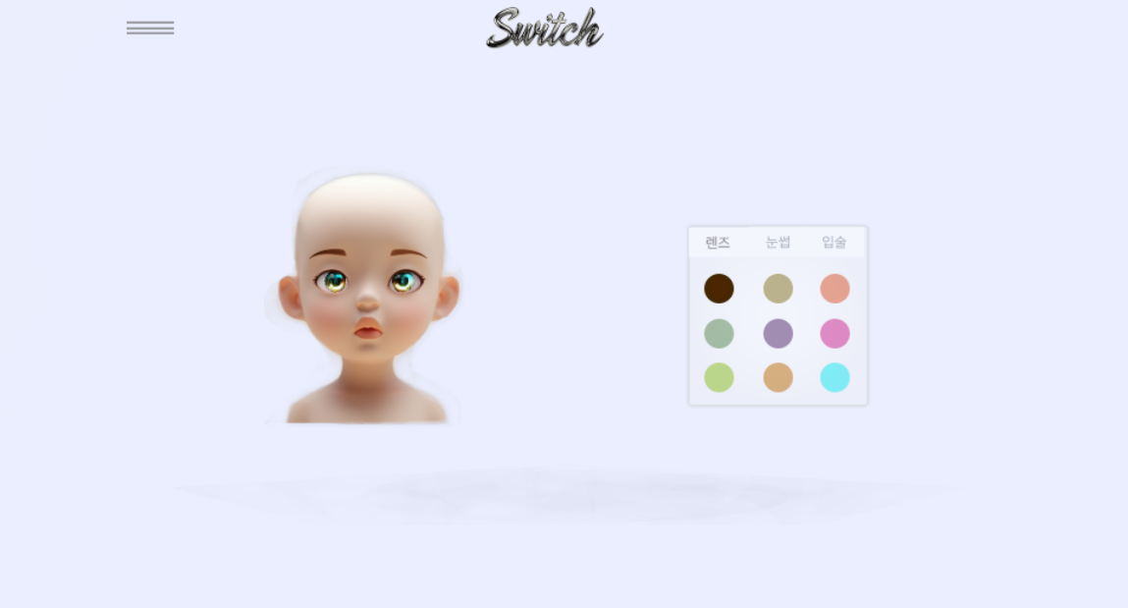
SUB2
©2025

Slide 32
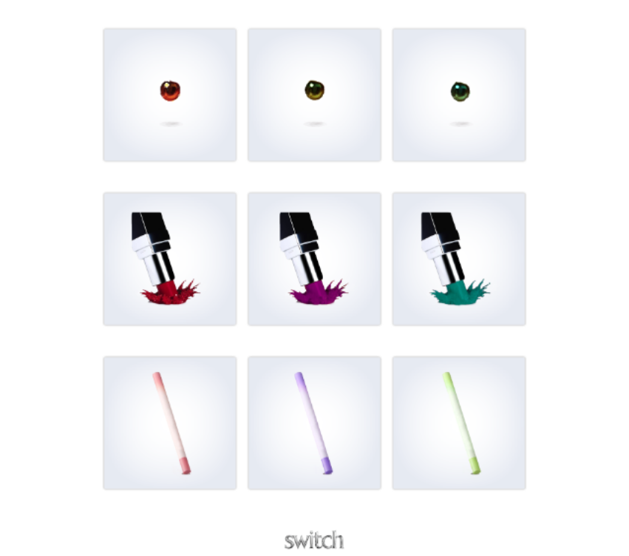
SUB2
©2025

Slide 33
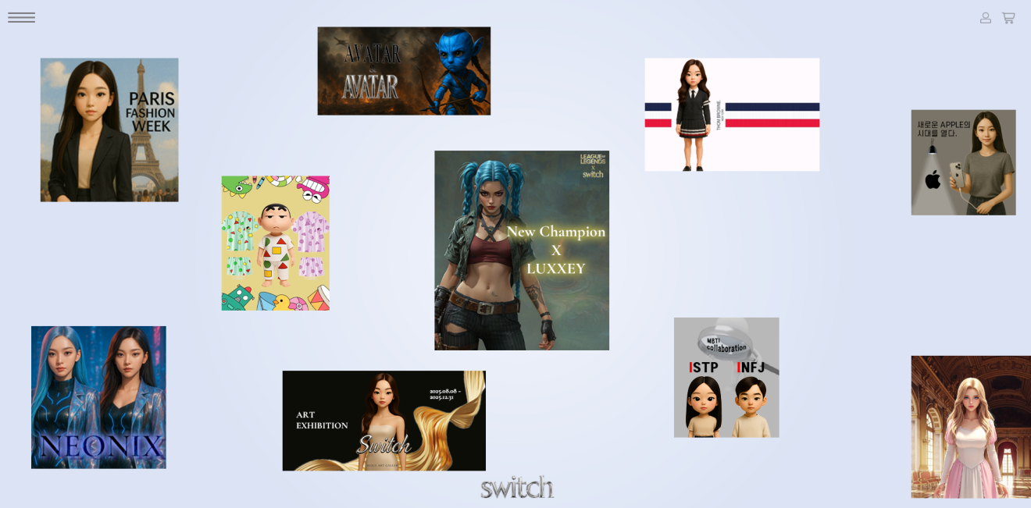
SUB3
©2025

Slide 34
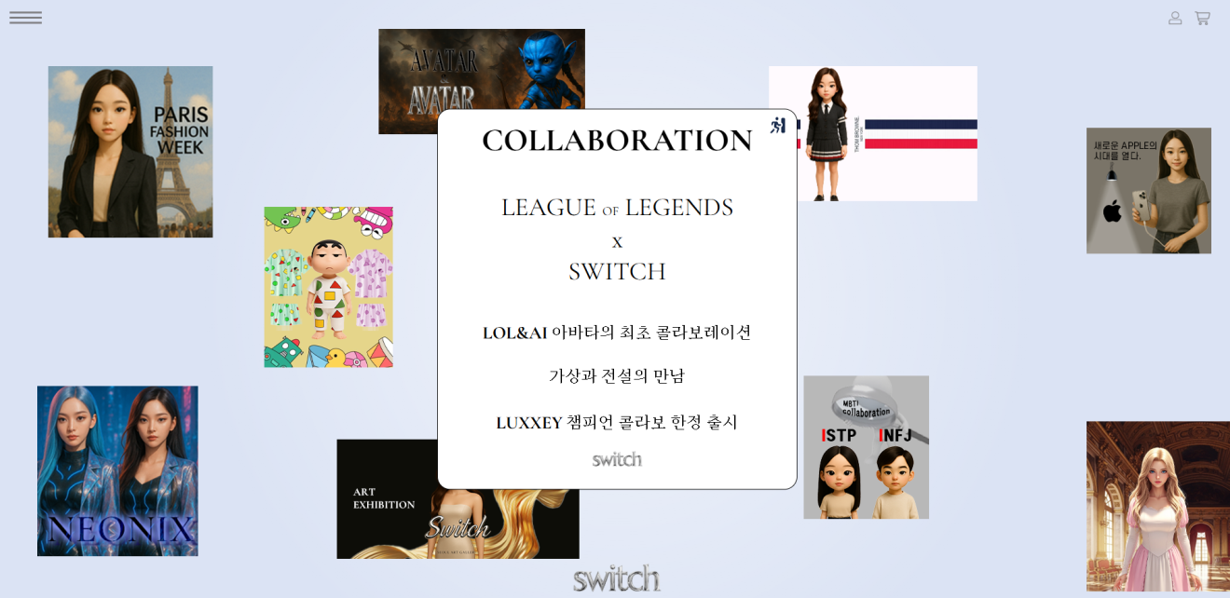
SUB3
©2025

Slide 35
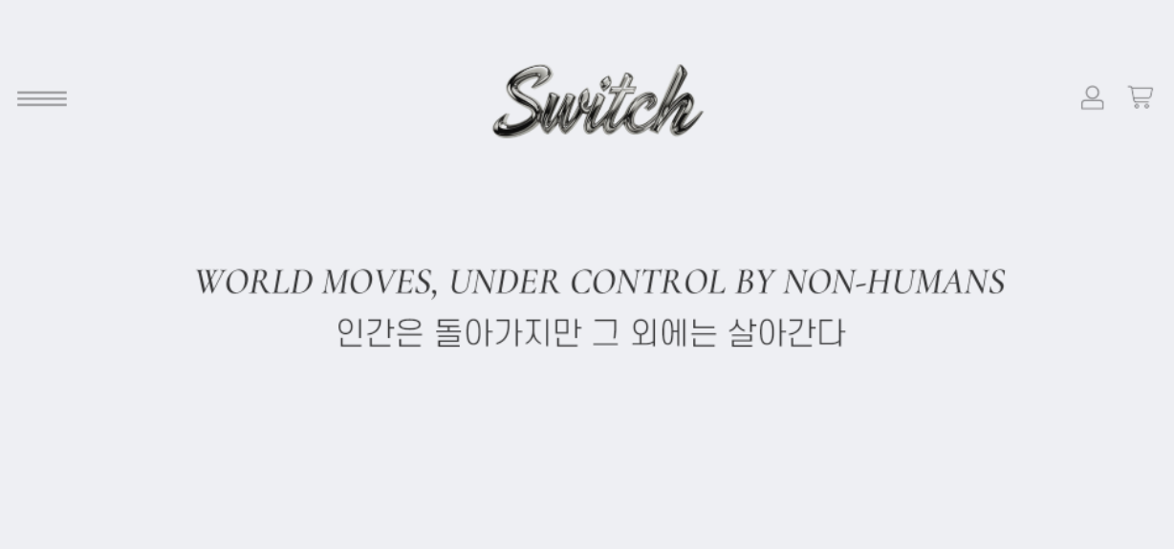
SUB4
©2025

Slide 36
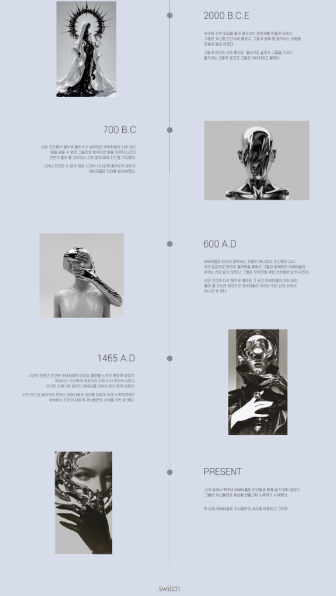
SUB4
©2025

Slide 37


















Max - width : 1200px
Max - width : 1024px
PC
PC
Media
Max-width : 768px
Max - width : 480px
Tablet PC
Mobile
©2025

Slide 38
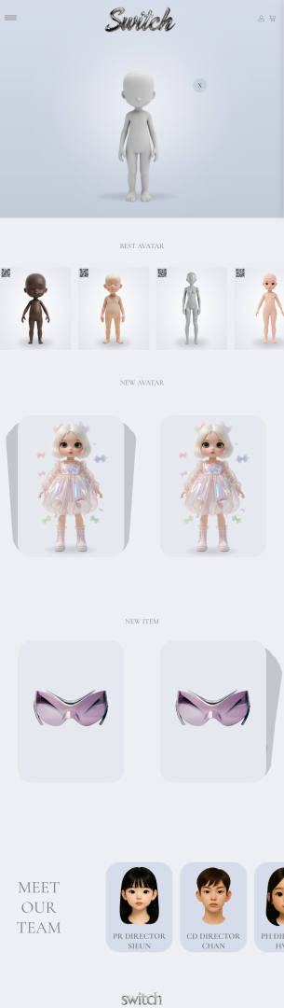
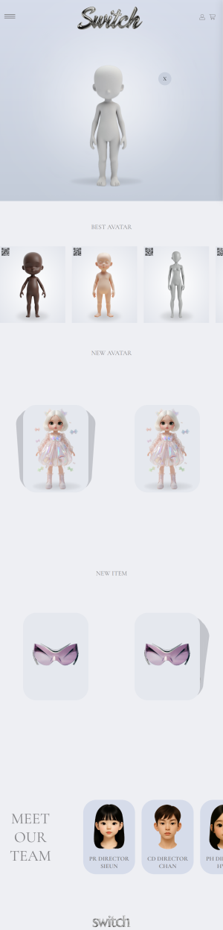
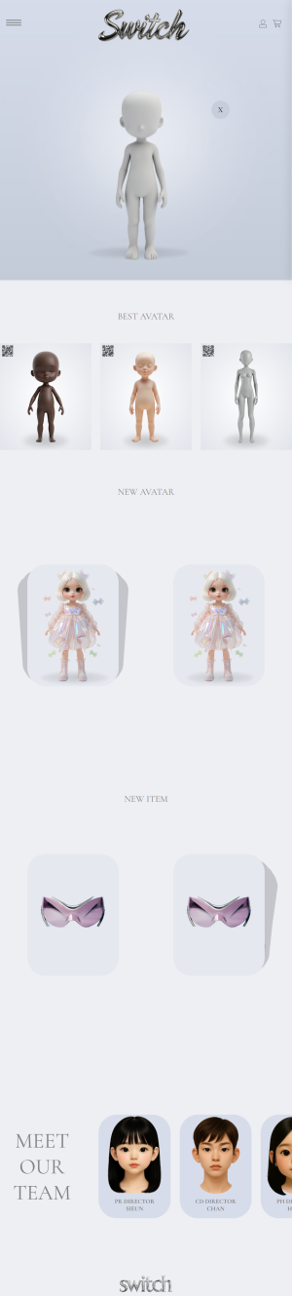
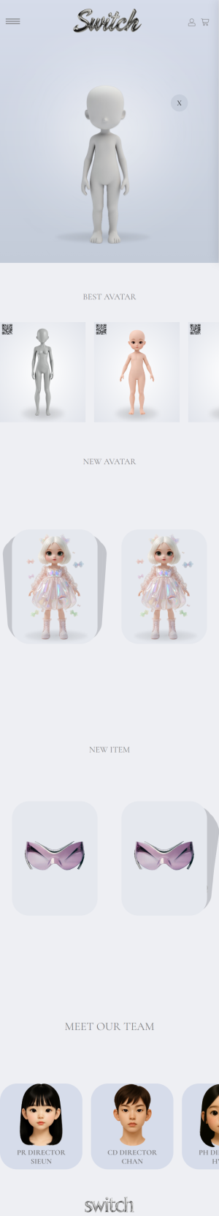
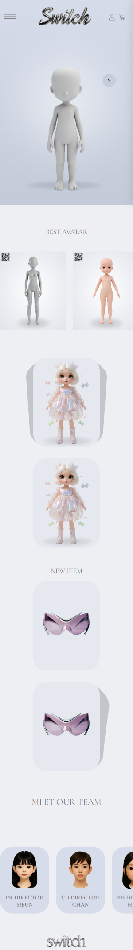
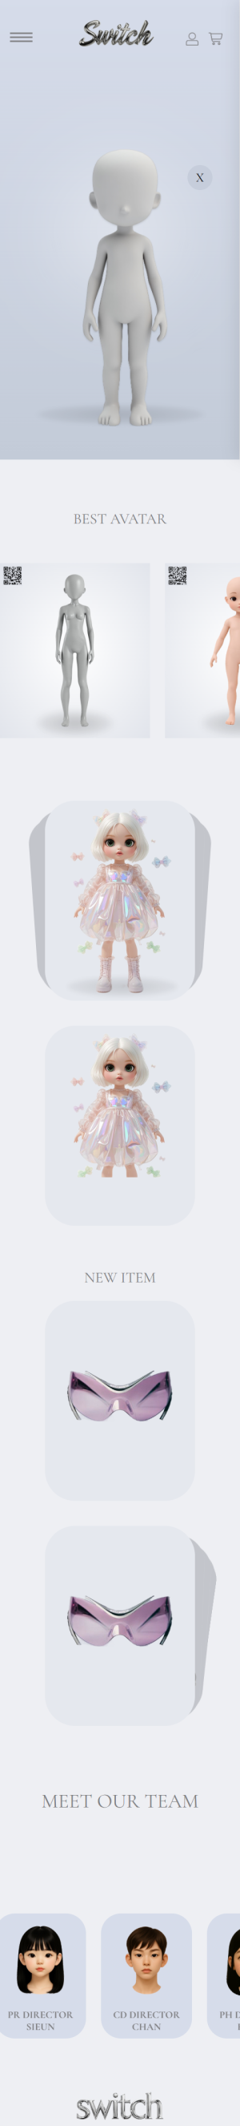
1200PX
1024PX
960PX
768PX
600PX
480PX
320PX
MAIN
©2025

Slide 39
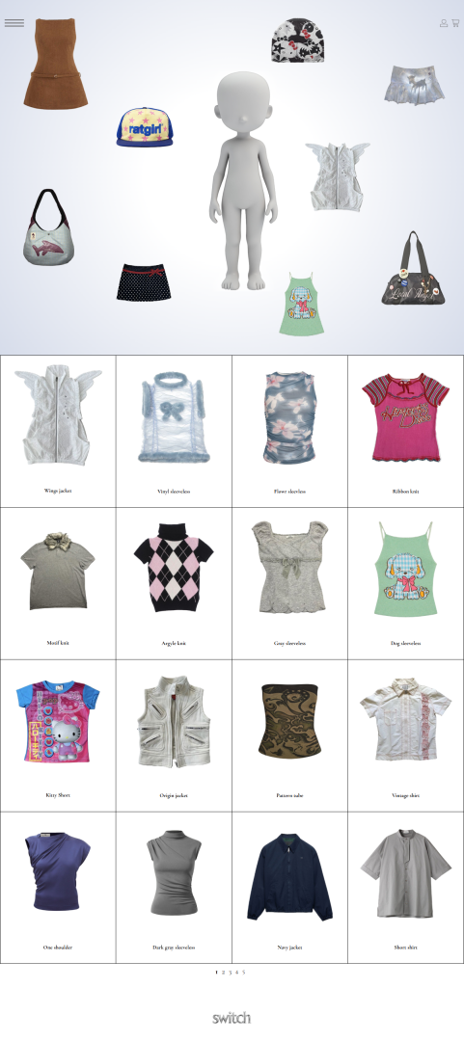
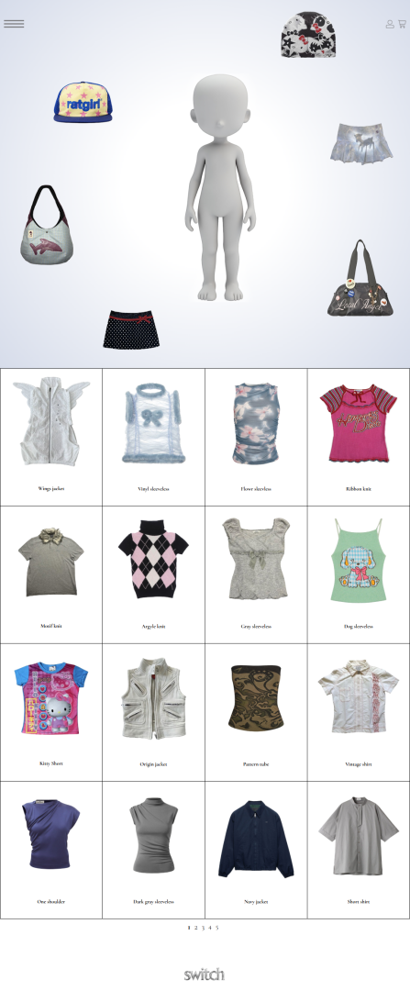
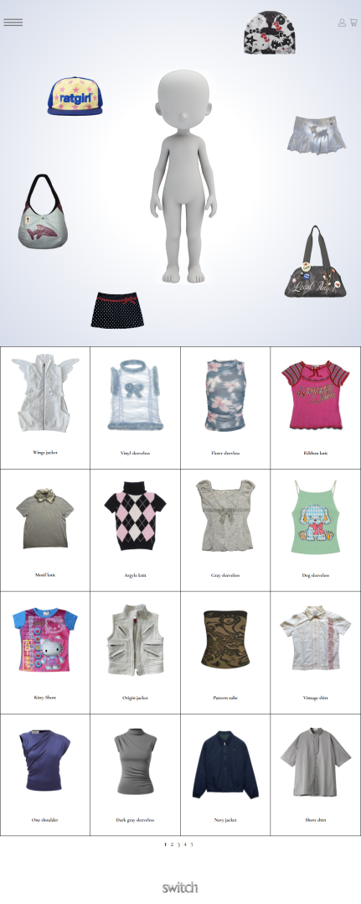
1200PX
1024PX
960PX
SUB1
©2025

Slide 40
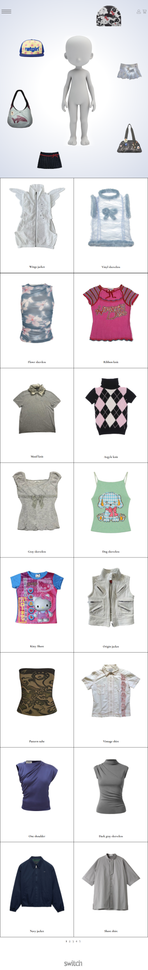
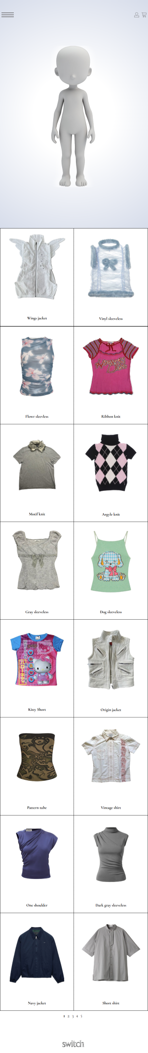
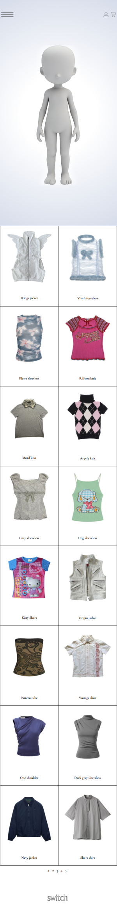
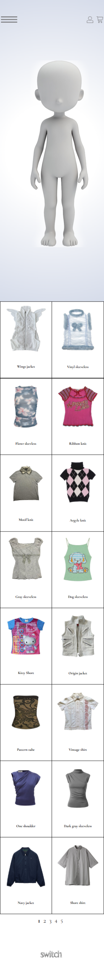
768PX
600PX
480PX
320PX
SUB1
©2025

Slide 41
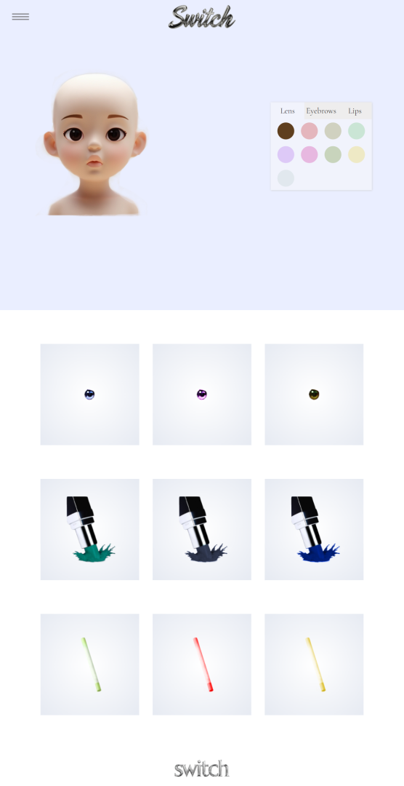
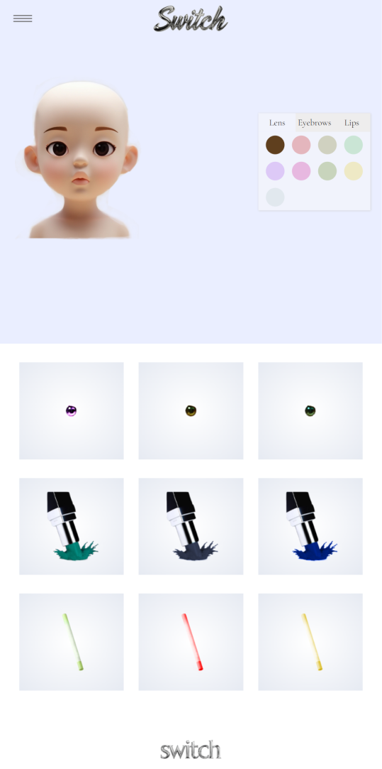
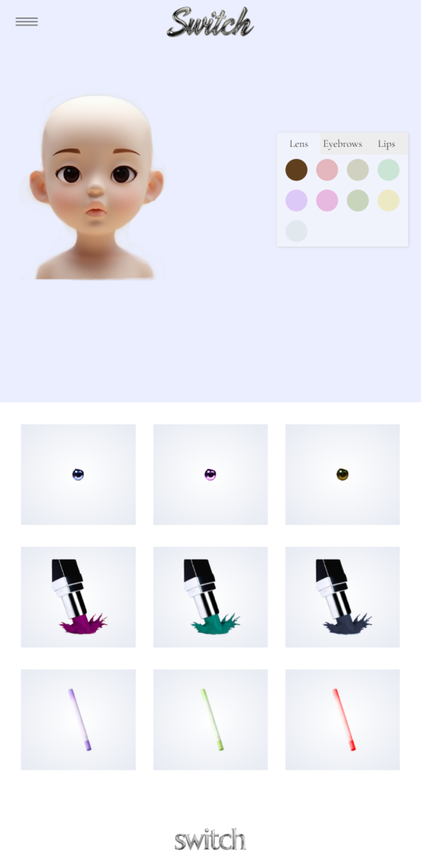
1200PX
1024PX
960PX
SUB2
©2025

Slide 42
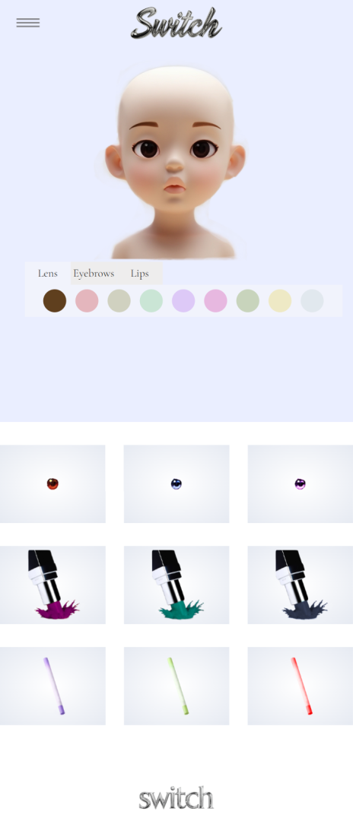
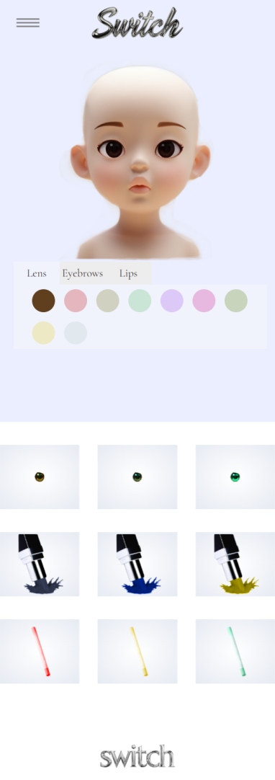


768PX
600PX
480PX
320PX
SUB2
©2025

Slide 43

1850PX
SUB3
©2025

Slide 44

1200PX
SUB3
©2025

Slide 45


960PX
768PX
SUB3
©2025

Slide 46



600PX
480PX
320PX
SUB3
©2025

Slide 47



1200PX
1024PX
960PX
SUB4
©2025

Slide 48




768PX
600PX
480PX
320PX
SUB4
©2025

Slide 49
Q&A

Slide 50
THANK YOU,
LET’S WORK TOGETHER
Sieun
@han_sieun
Yeongchan
@____zerosugar
Chaihwan
@chai_hwan
Minju
@m._.chuuuu
©2025

